Slide 1


Compressive strength in concrete
Presented By:
1. R.Maribala-Solamalai College of Engineering-Civil Engineering

Slide 2
OUTLINE
○
Probelm Statement
Proposed Solution
System Approach
Algorithm & Deployment
Result
Conclusion
Future Scope
References
○ ○ ○ ○
○
○ ○

Slide 3
PROBLEM STATEMENT
This dataset comes from research by Civil Engineering department.
The aim of the study is to determine Compressive stress is the type of longitudinal stress that works on deforming the material like reducing the volume of the material. To improve compressive strength in concrete.

Slide 4
PROPOSED SOLUTION
Setting Parameters
*Including admixtures
Adjusting the cement type and quantity
*Reducing the water/cement ratio
*Utilizing supplementary cementitious materials (SCMs)
*Altering the aggregates - type and gradations

Slide 5
SYSTEM APPROACH
Building the proposed solution would involve a combination of data processing,feature engineering,and machine learning. Here are the key system and library requriements.
System Requirements:
1.Hardaware:
A computer with sufficent processing power,perferably wwith multiple cores or a GPU for faster traning of machine learning models.
Adequate RAm to handke the size of the saraset and computational requriments.
2. Software:
An operating syatem compatible with the requrired machine learning libraries(eg., Windowa=s, linux,macsOS).

Slide 6
ALGORITHM & DEPLOYMENT
Deep neural networks (DNN)
Deep neural networks (DNN) is a class of machine learning algorithms similar to the artificial neural network and aims to mimic the information processing of the brain.
Steps to implement the DNN algorithm:
Data collection
Feature extraction
Information processing
Model training
Performance evaluation

Slide 7
ALGORITHM & DEPLOYMENT
Python programming language
The definition of a program at its most basic is a sequence of Python statements that have been crafted to do something. Even our simple hello.py script is a program. It is a one-line program and is not particularly useful, but in the strictest definition, it is a Python program.

Slide 8
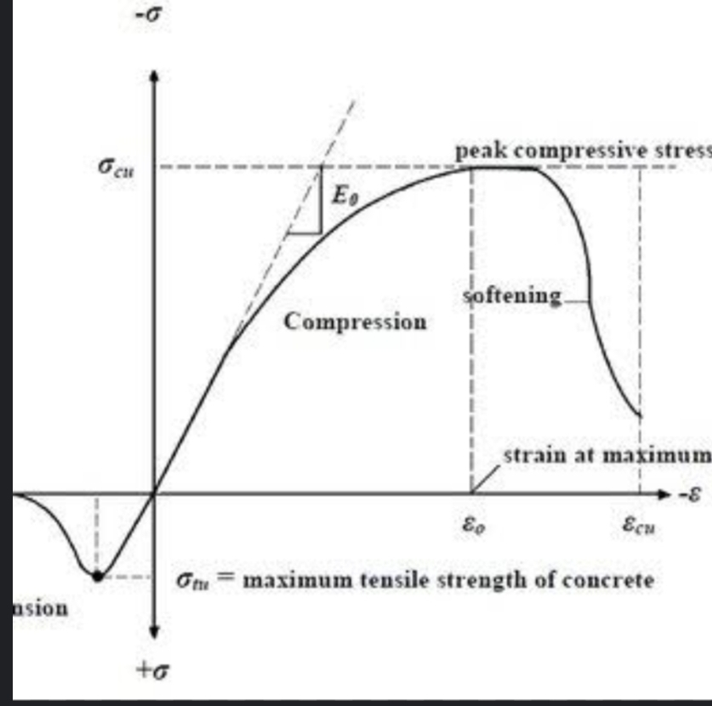
RESULT

Slide 9
CONCLUSION
To develop and improve the innovation idea about future goals french and other cities

Slide 10
FUTURE SCOPE
The future and innovation idea of tech and non techinical world

Slide 11
REFERENCES
https://www.kaggle.com/datasets/afumetto/3dprinter

Slide 12
THANK YOU

